Slide 1
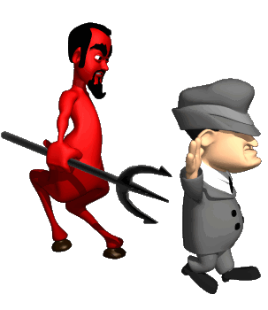
KNOWING OUR ENEMY I. The nature Of Spiritual Warfare 1. Can Christian be under attack?

Slide 3
I. Warnings concerning spiritual warfare A. Principalities and Powers（Eph 6:10-13) 1. The Need to be spiritually strong（Ps 62:1-4) a. Trusting in His might and Power － Not by our intelligence（1 Cor 1:19） b. Why is it necessary? － We are in spiritual warfare

Slide 4
Spiritual Warfare is not a “fleshly” war Eph6:10-13 A. Who is the real enemy (v12） － Not against flesh and blood B. Against Principalities, powers, (1) Principalities (GK: archai), the highest-ranking evil spirit. (2) Powers (GK: exousia), highly ranked evil spirits, which authority to influence the welfare of people in different strata of societies. (3) Rulers (GK: Kosmokratoras) of darkness: These have assigned powers to wreak havoac and leading people into darkness. (4) Spiritual hosts of wickedness (GK: poneria): These have delegated powers to cause people to indulge in wicked thoughts. They are numerous in numbers and they exist in all places. C. Rulers of darkness of this world wickedness in high places － make us of people and circumstances － to deceive

Slide 5
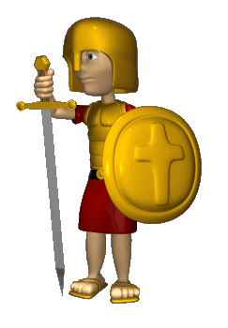
2. The Whole Armor of God is required (Eph 6:11,13) a. God has prepared for us a whole armor － for us to resist the the enemy － to stand firmly b. Putting on the amour is our responsibility － put (v11) － take (v13) － application

Slide 6
3. God’s warning concerning the influence of sin (Matt 24:12-13) 4. God’s will in our lives － fruits bearing 5. Satan wants to depletes our strength (Heb 12:13; Rev 2:3) －through discouragement, - despondency and despair

Slide 7
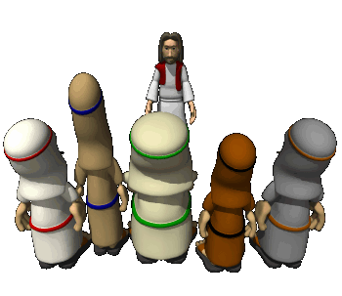
II. The Need to be sober (1 Peter 5:8) a. Vigilant，cautious - Mark 13:33 b. Your enemy, the devil - 1 Peter 5:5-6 c. roams around like a roaring lion devours =，gobble, swallow

Slide 8
IS ANYTHING REQUIRED OF THE BELIEVER？ A. The responsibility of the Believer 1．To keep himself 1 Jn 5:18 - from idols 1 Jn 5:21 - - In the love of God Jude 21 2. To follow Jesus Jn 14:30-31 - nothing in me 3. To watch and pray Matt26:41 4. To pray in the spirit Jude 20 5. To Keep the anointing - the yoke is destroyed Is 10:27 6. To abide in Christ Ps 91:1 - under God’s protection

Slide 10
THE SIGNIFICANCE OF PRAYER & INTERCESSION IN SPIRITUAL WARFARE
1. A Powerful Spiritual Weapon
It can be fired to any spot on Earth – Psa 2:8
It travels at the speed of thought
It always hits its target
2. A Tremendous Weapon
There is no defense against it – Mt 16:18,19
The gates of Hell shall not prevail against it
3. Unleashing God’s Power On Earth

Slide 11
PRAYING IN THE SPIRIT 1.God’s command – Isa 41:13,14 a. do not fear b. fear rules out faith 2. God’s word of comfort a. I am with you b. I will hold your hand 3. God’s provision – Isa 41:15,16 a. I will give you a new sharp instrument b. God’s promise c. I will enable you to conquer d. I will make you victorious

